Slide 1
PROJECT NAME: SCHOOL ADMISSION PORTAL
Group Members:
Maaz hassan
Abdullah Akbar
Mujtaba Imtiaz
Mohammad Sarim
Ali
Course Instructor: Miss Ramsha Khalid

Slide 2

ABOUT BRIGHT FUTURE PUBLIC SCHOOL
At Bright Future Public School, we are deeply committed to nurturing young minds with a high standard of quality education. Our philosophy centers on creating an environment where every child can thrive.
We focus on fostering creativity, ensuring student safety, and promoting holistic development, preparing students not just academically, but as well-rounded individuals ready for the future.
Serving our community with unwavering transparency and embracing innovative approaches, we strive to make the admission process reflective of our core values.

Slide 3
BRIGHT FUTURE PUBLIC SCHOOL
Why Do We Need a Student Admission Portal
Streamlined
Admissions
Simplify and centralize the entire admission process for both parents and administrative staff, making it more efficient and less time-consuming.
Reduced Errors & Paperwork
Minimize manual data entry, significantly reducing the chances of errors and decreasing the extensive paperwork traditionally associated with admissions.
24/7 Accessibility
Provide continuous access for families to apply, check application status, and obtain crucial information at their convenience, anytime, anywhere.

Slide 4

USER EXPERIENCE: PARENTS & STAFF
For Parents
Apply for admission at their convenience, 24/7.
Track the real-time progress of their child's application.
Receive automated updates and notifications regarding status change.
For staff
Efficient review and management of all applications.
Seamless communication with applicants and internal teams.
Informed decision-making with organized student profiles.

Slide 5
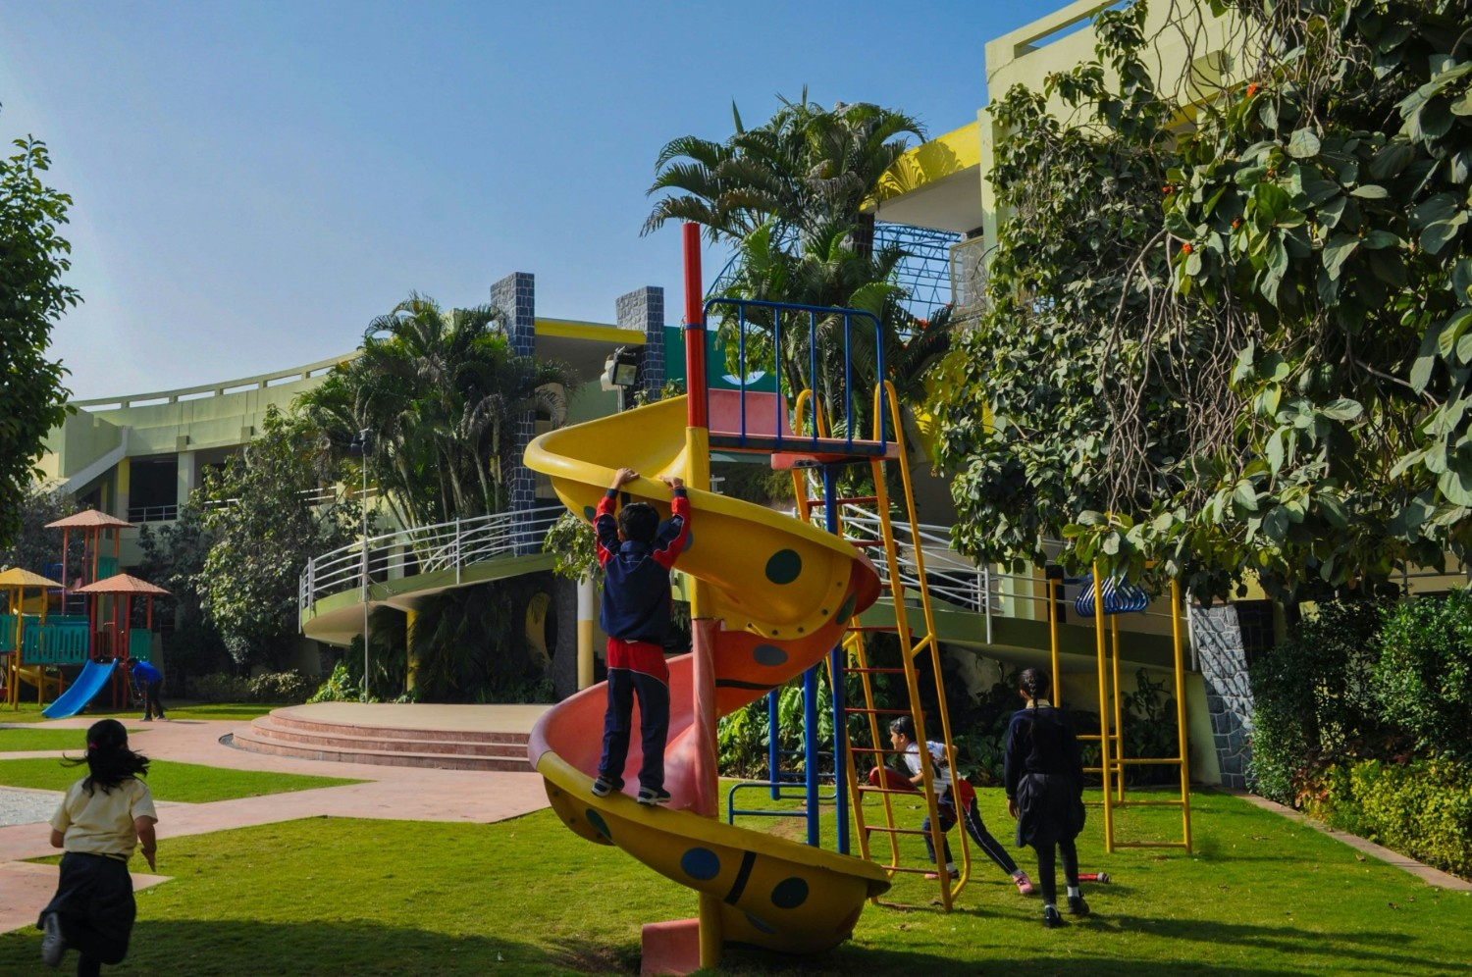
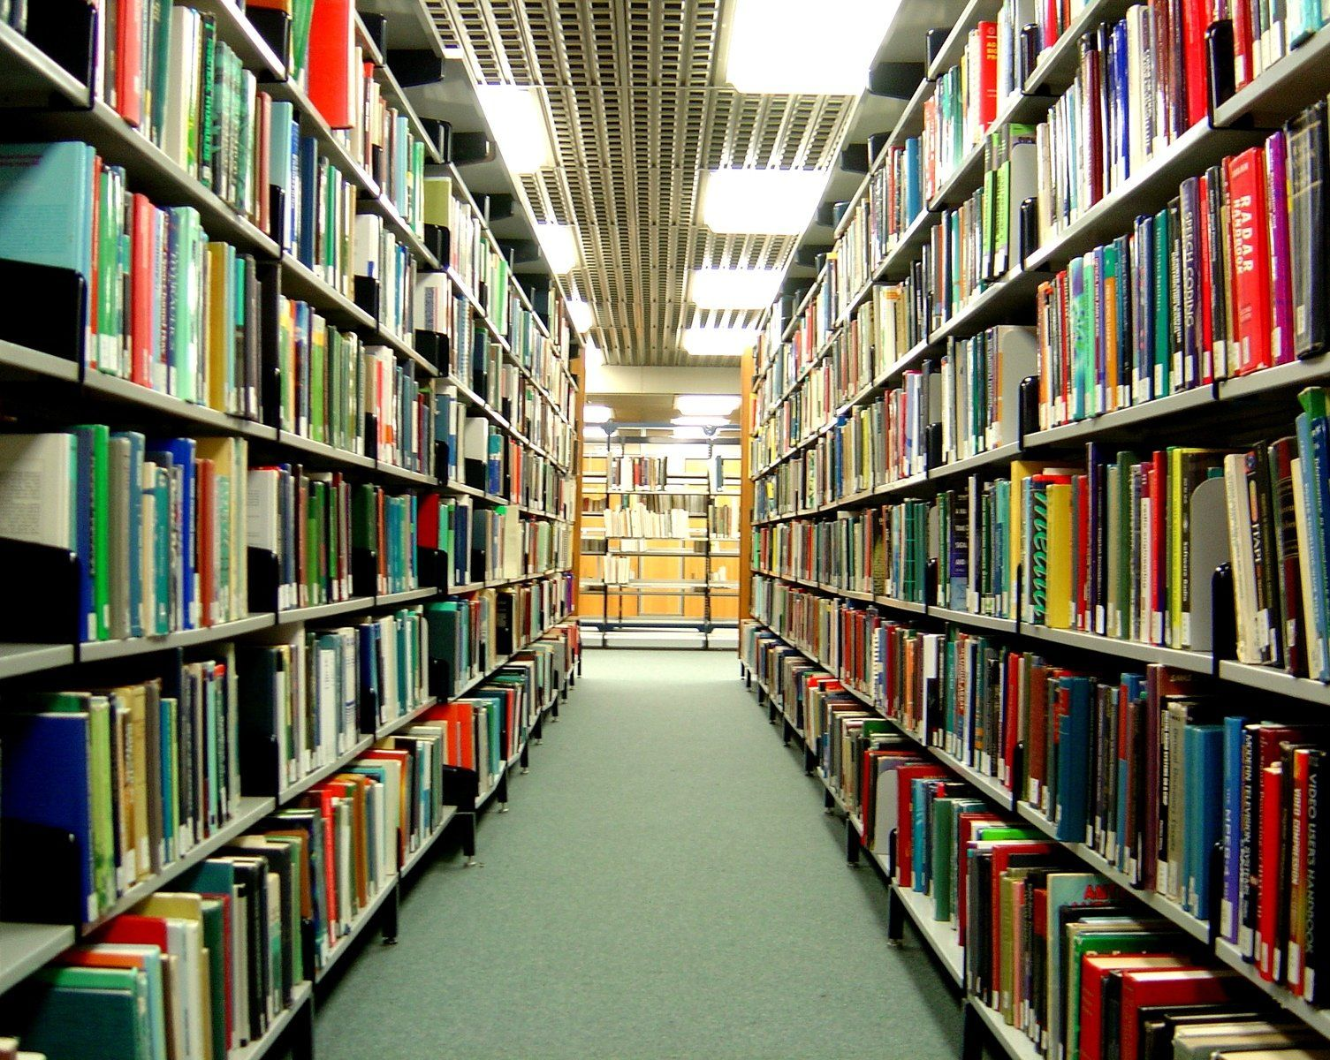
Cocurricular activities
Bright Future Public School provides playground facilities to encourage games, physical activity, and student motivation.
The library at Bright Future Public School promotes knowledge, curiosity, and independent learning through a wide range of books and study resources.

Slide 6

Success Metrics & Future Enhancements
Key Metrics
Our primary goal is to achieve significant adoption and efficiency:
Target: 90% of all admissions processed online within the first year of operation.
High user satisfaction ratings from both parents and staff.
Demonstrable reduction in administrative time spent on admissions.
Future Growth
Implement a feedback system for ongoing enhancements and user-driven improvements.
Integrate online fee payment modules for a fully seamless financial process.
Develop comprehensive student onboarding modules to welcome new students effectively.

Slide 7
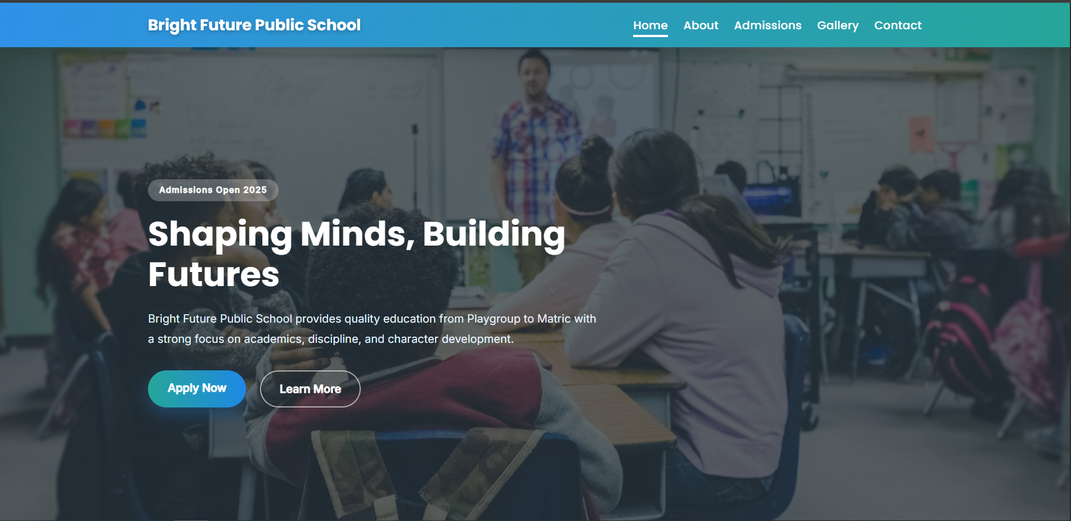
Website Demonstration – Home Page
School introduction and highlights
School introduction and highlights
Admission announcement and call-to-action

Slide 8
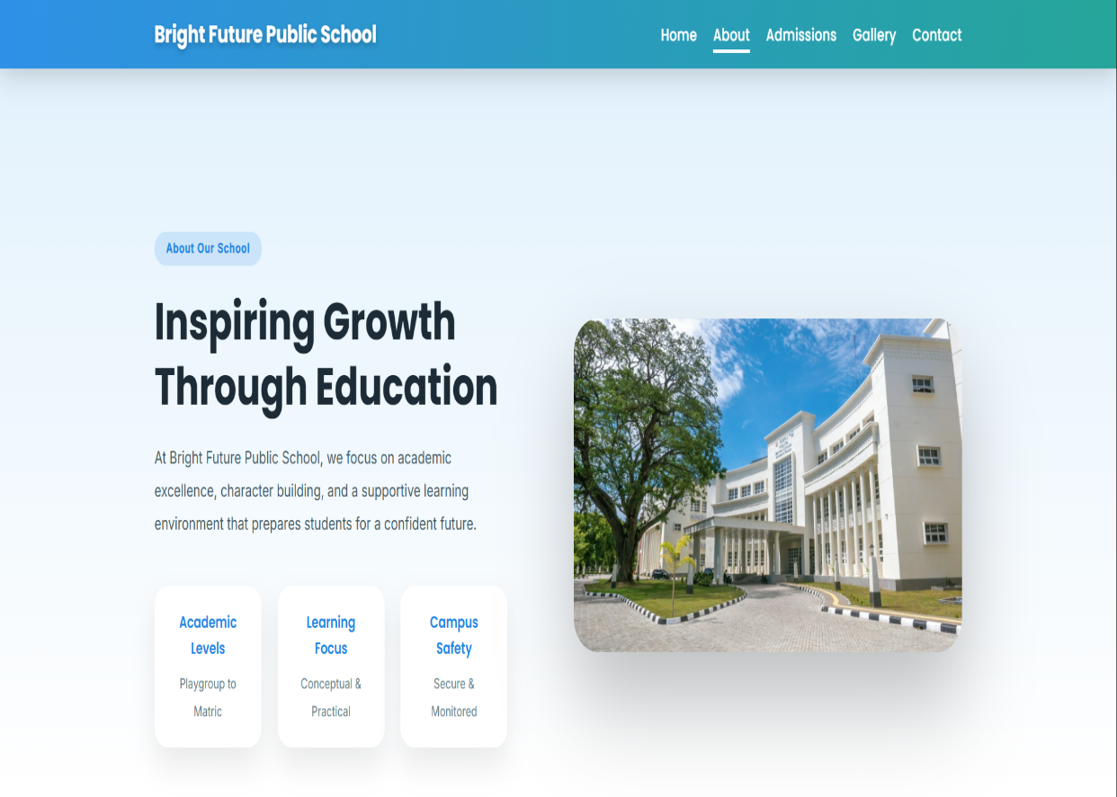
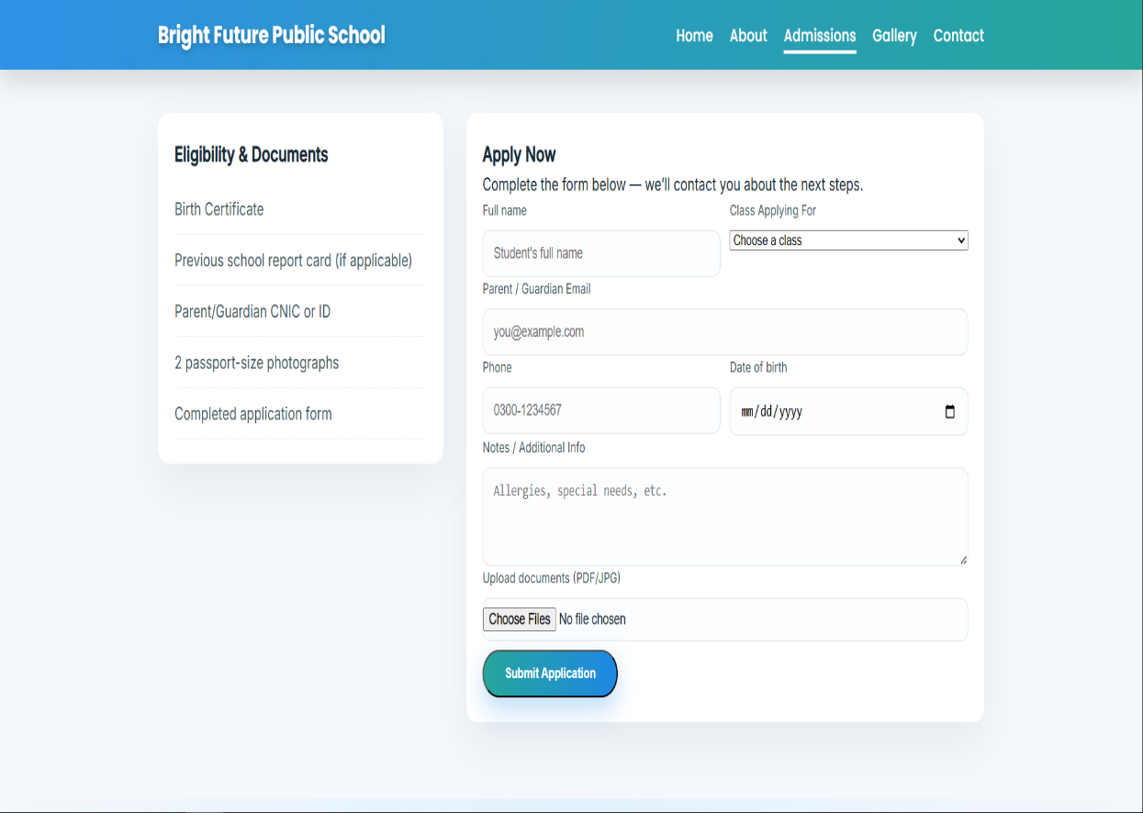
Website Demonstration About & Admissions
School vision, mission, and values
Admission structure and class levels

Slide 9
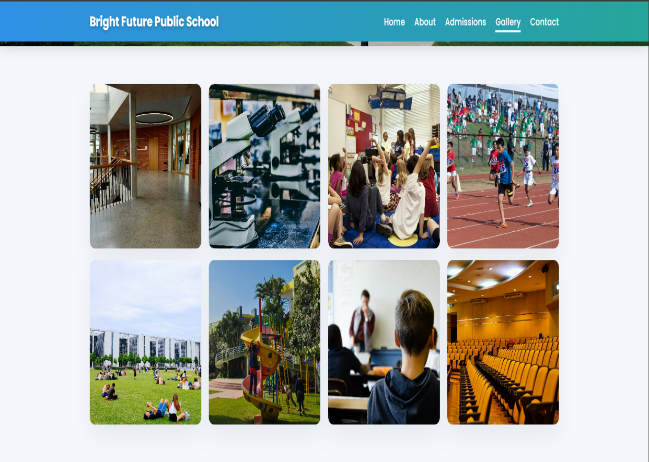
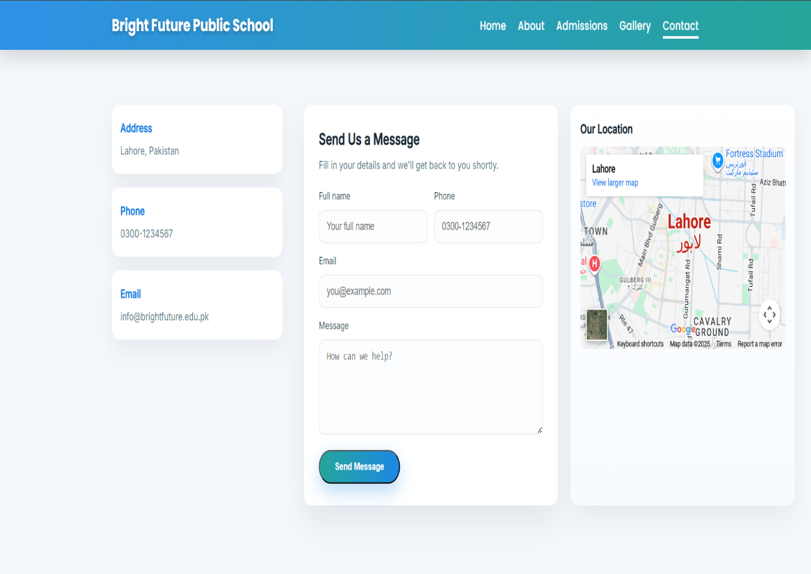
Website Demonstration – Gallery & Contact
Visual presentation of school facilities
Contact information for inquiries

Slide 10
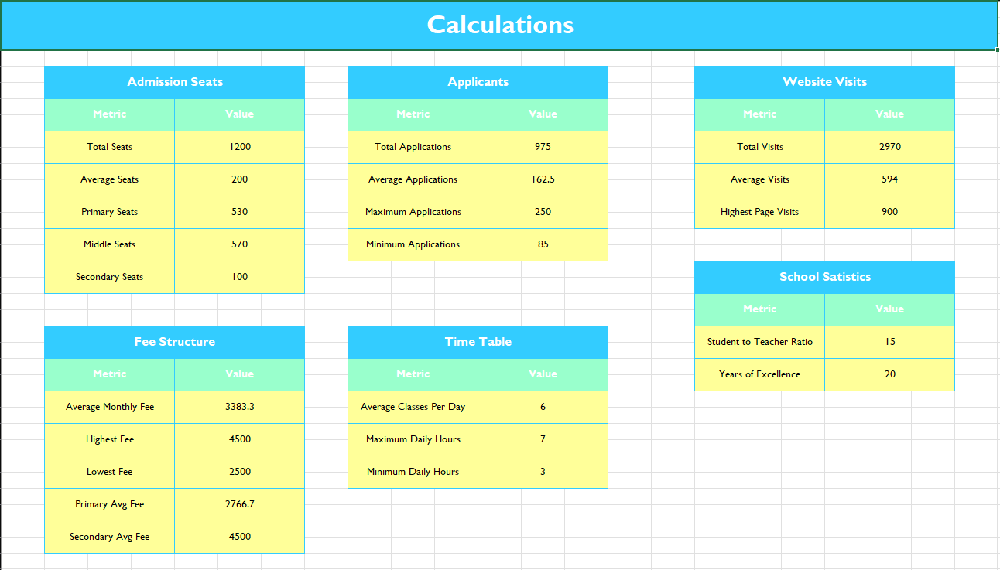
Data Analysis Using Microsoft Excel
Raw admission and fee data collected
Calculations using SUM, AVERAGE, and IF functions

Slide 11
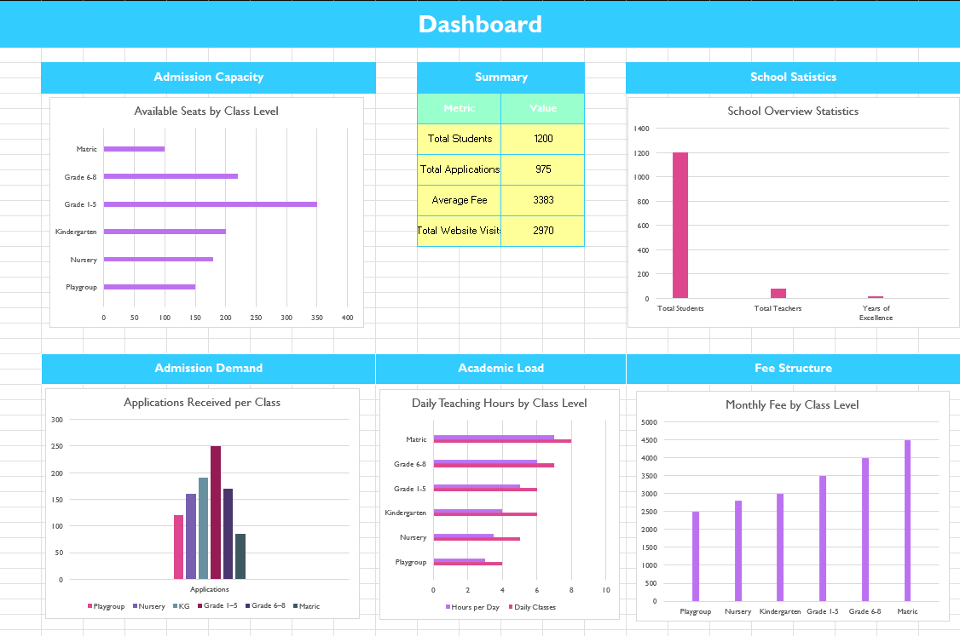
Excel Dashboard & Key Insights
Admission distribution and website usage visualized
Charts used for quick insights and decision-making

Slide 12
Design Decisions
Consistent color palette suitable for an educational institute
Clean typography for readability
Responsive layout using CSS media queries
Responsive layout using CSS media queries

Slide 13
Live Website & GitHub Repository
🌐 Live Website:
https://your-username.github.io/school-admission-portal/
💻 GitHub Repository:
https://github.com/your-username/school-admission-portal
📌 Hosted using GitHub Pages

Slide 14
Reflection & Future Enhancements
What We Learned
Web development using HTML & CSS
Data analysis using Excel dashboards
Team collaboration using GitHub
Future Improvements
Online admission form integration
Backend database support
Admin dashboard

Slide 15
Thank you!
Collaborators:
Muhammad Mujtaba Imtiaz
Maaz Hassan
Muhammad Sarim
Abdullah Akbar
ALI

